Slide 1

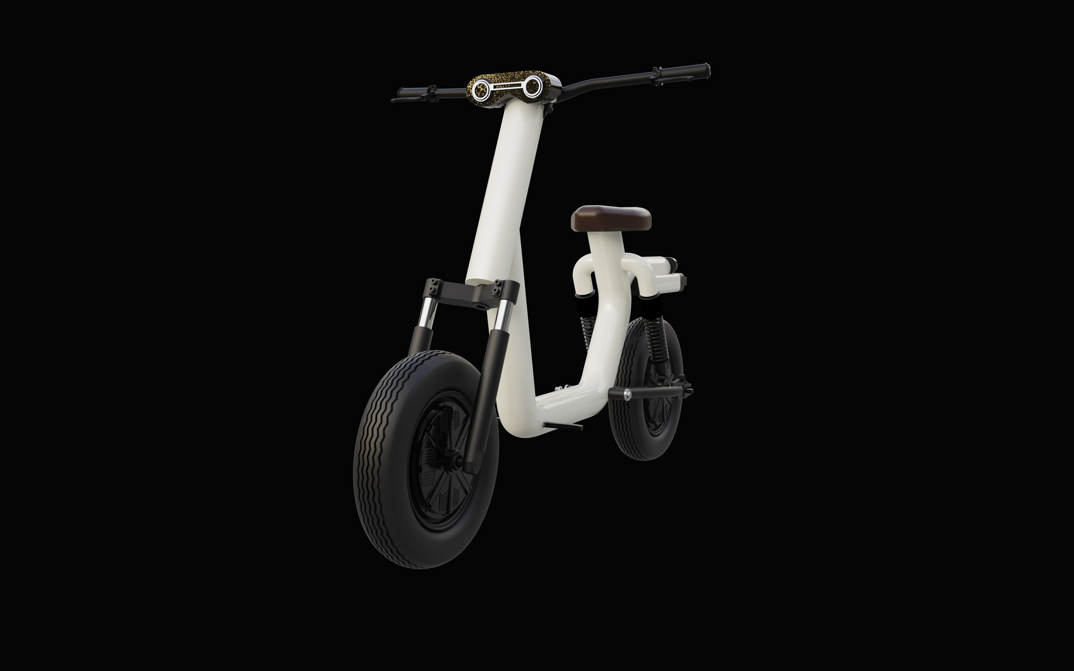
TM
About Technology Models Contact
T H E F U T U R E O F M O B I L I T Y I S H E R E
C O M I N G S O O N

Slide 2
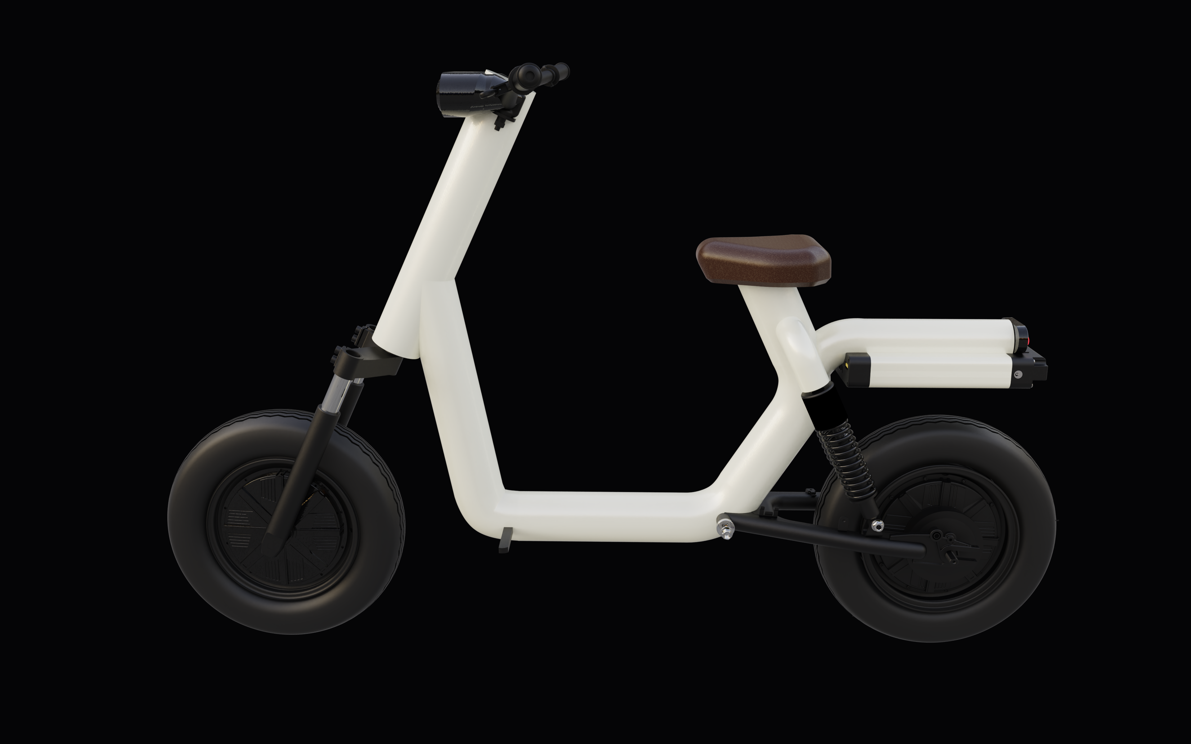
V I S I O N
We’re Changing the
Way the World Thinks
About Transportation
I'm a paragraph. Click here to add your own text and edit me. It’s easy. Just click “Edit Text” or double click me to add your own content and make changes to the font. I’m a great place for you to tell a story and let your users know a little more about you.

Slide 3
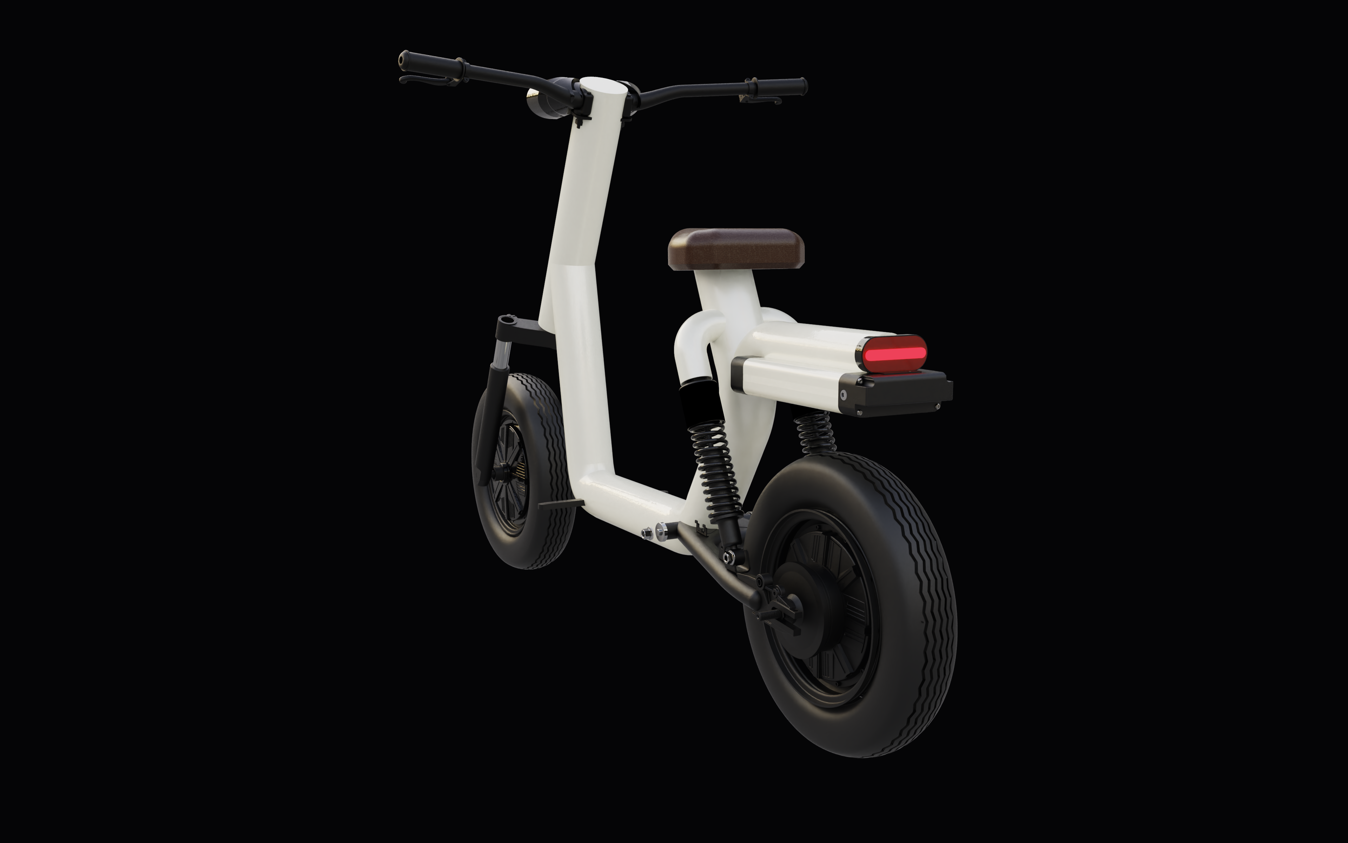
S E R V I C E S
We Deliver Exceptional
Products and Services
Around the World
AUTONOMOUS DRIVING
I'm a paragraph. Click here to add your own text and edit me. It’s easy. Just click “Edit Text” or double click me to add your own content and make changes to the font. I’m a great place for you to tell a story and let your users know a little more about you.

Slide 4
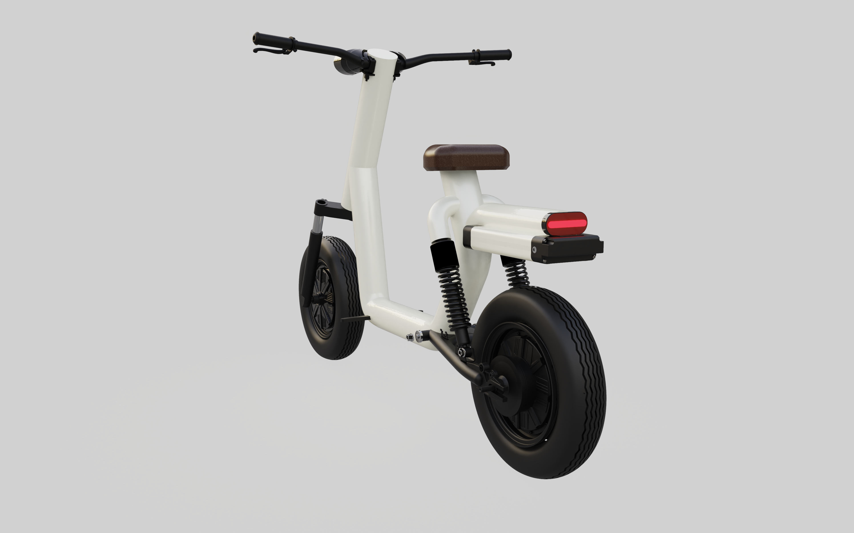
S E R V I C E S
We Deliver Exceptional
Products and Services
Around the World
AUTONOMOUS DRIVING
I'm a paragraph. Click here to add your own text and edit me. It’s easy. Just click “Edit Text” or double click me to add your own content and make changes to the font. I’m a great place for you to tell a story and let your users know a little more about you.

